Slide 1

Obligatory Assignment 01
Due 10 Feb, 15.00

Slide 2

Scalable Vector Graphics (SVG)
Using svg tags draw the Norwegian flag as shown on the left.
You are allowed to use <polygon>, <rect>, <line>, etc but <img> tag is not allowed.
Obligatory Exercise: Task 1

Slide 3
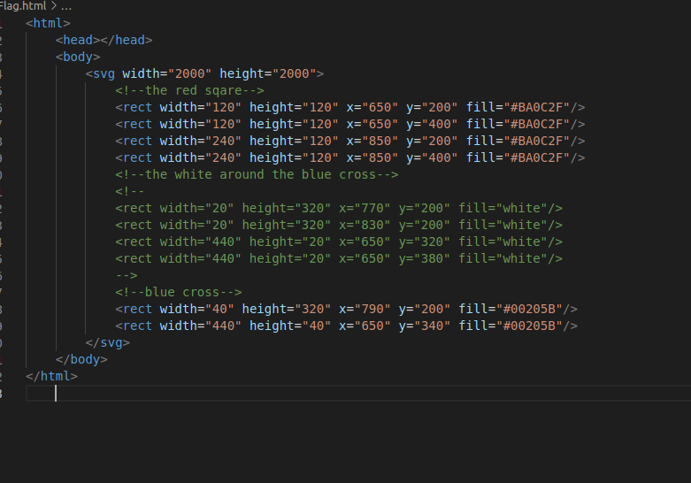

Slide 4


Slide 5

Title of your website
Description of the website….
A simple SVG logo (e.g. a circle, square etc.)
Your website’s content goes here. (your content should include lists, images, links)
A table using table tag.
Obligatory Exercise: Task 2. [The task is to make a webpage (i.e., html file) containing necessary tags.]

Slide 6
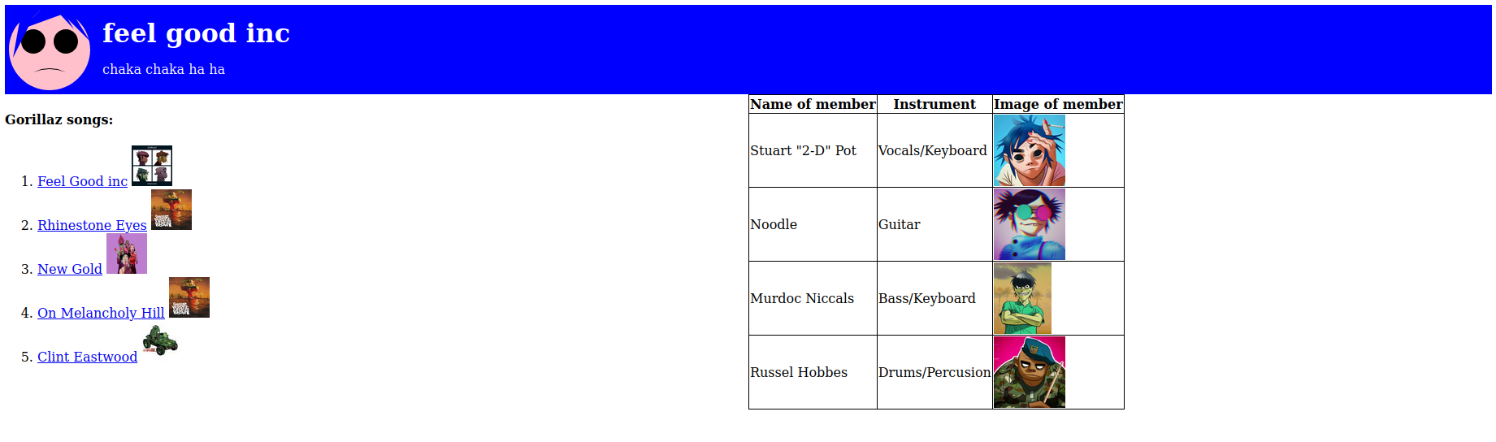

Slide 7
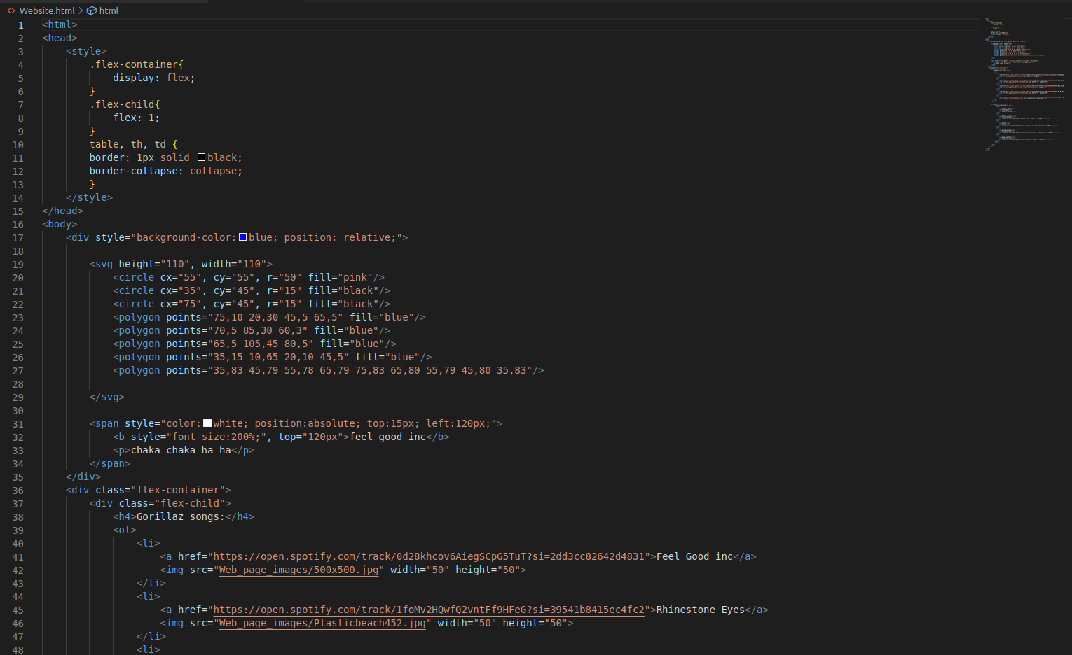

Slide 8
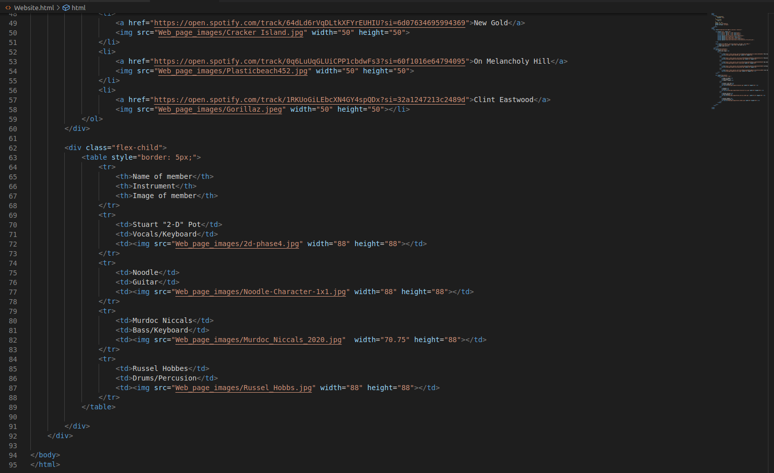

Slide 9
Pick a website you wish (for example www.google.com). Using ping utility (window/macOS) and wireshark find answer to the following questions:
Run <ping -n 5 www.yoursite.com> or <ping -c 5 www.yoursite.com> in your cmd/terminal while sniffing the network by wireshark.
What is the IP address of the website you pick?
How many packets have you captured overall and how many have you captured from this website?
What protocol does the ping utility use?
Using only wireshark, compute the RTT (Round Trip Time) – how long it took since your ping request was sent and until the ping reply was received?
How many TCP packets have your computer sent or received?
Obligatory Exercise:: Task 3

Slide 10
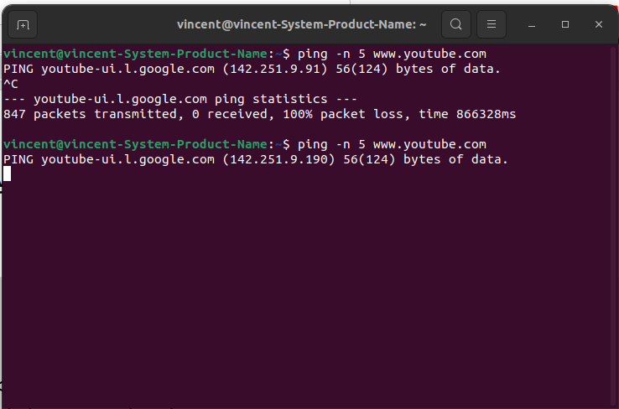
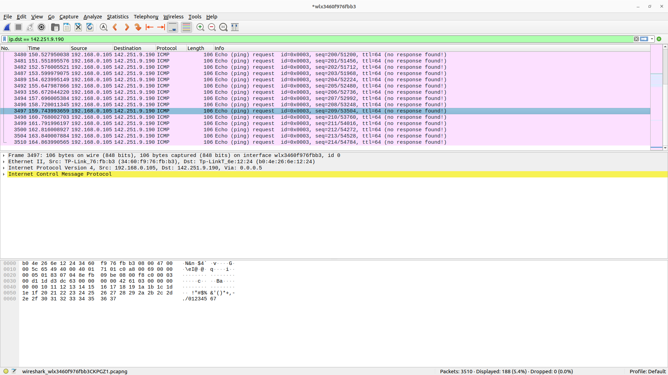
Site chosen: www.youtube.com
a)
pinging youtube
wireshark image of packets filtered by destination IP
b) 142.251.9.190
c) I have captured 3510 total packages as seen on the wireshark image. By filtering by destination
IP I can find every ping I sent to 142.251.9.190

Slide 11
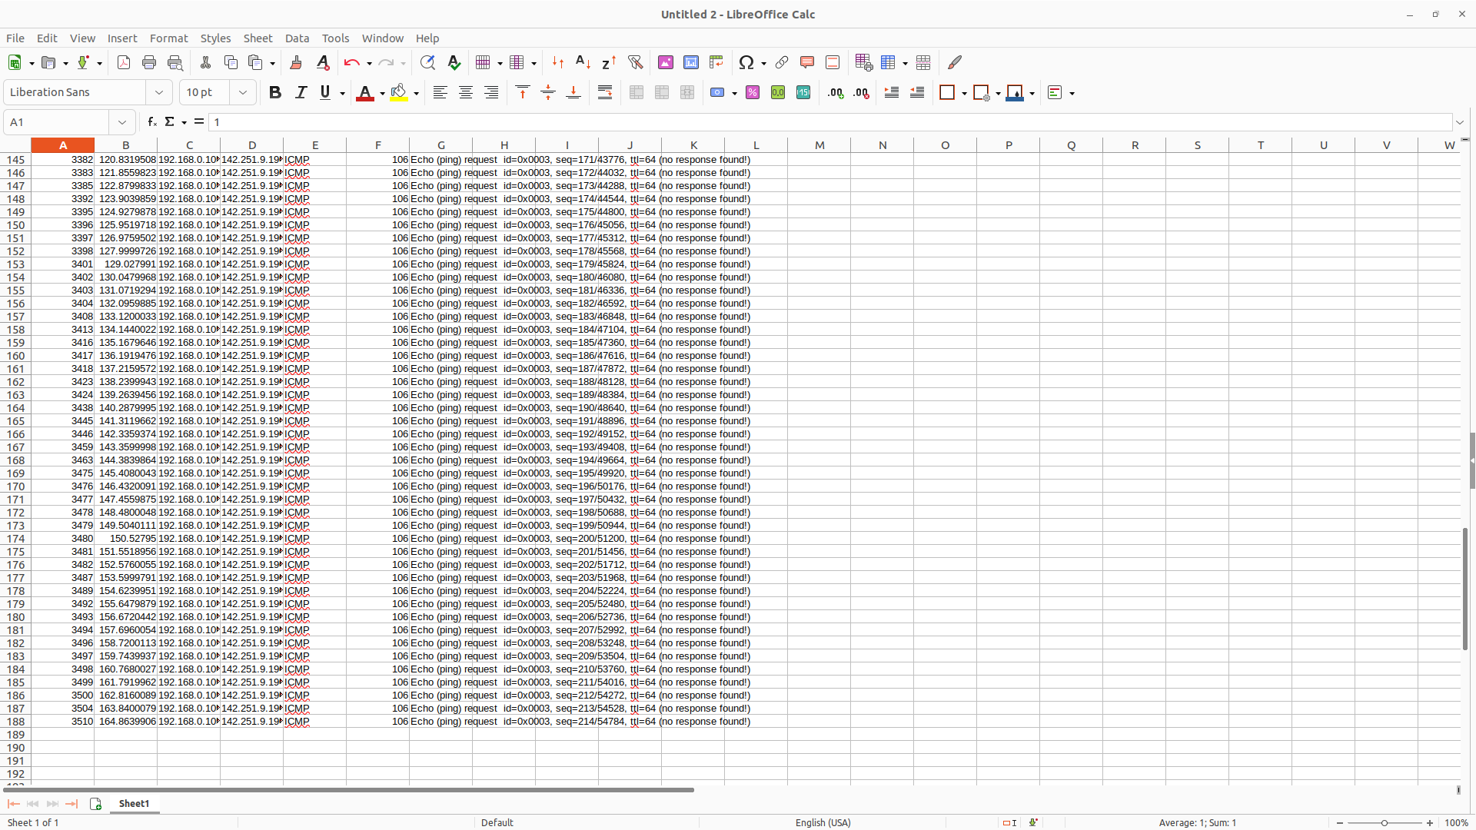
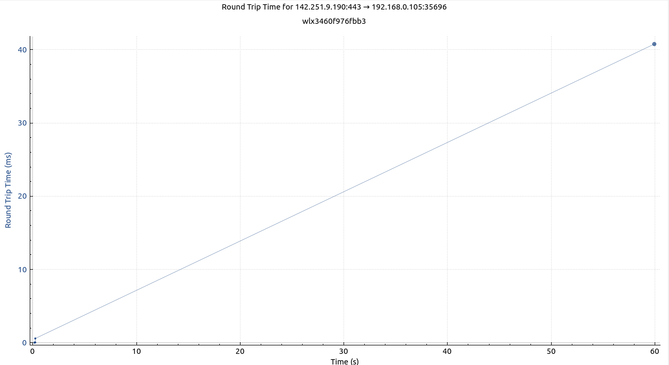
by copying and pasting into a spreadsheet I get the total number of packets captured from that IP: 1
my spreadsheet then tels me that from youtube I have captured: 188 packets
d) ICMP as seen in the protocol column of the wireshark image
e) using TCP graph I calculated the round trip time for the youtube ip:

Slide 12
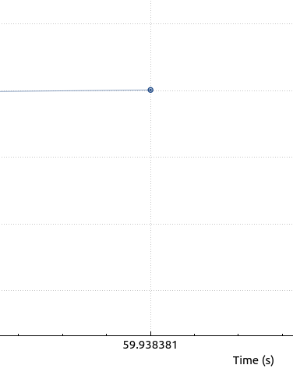
is the total round trip time for youtube, but no ping was received.
f)

Slide 13
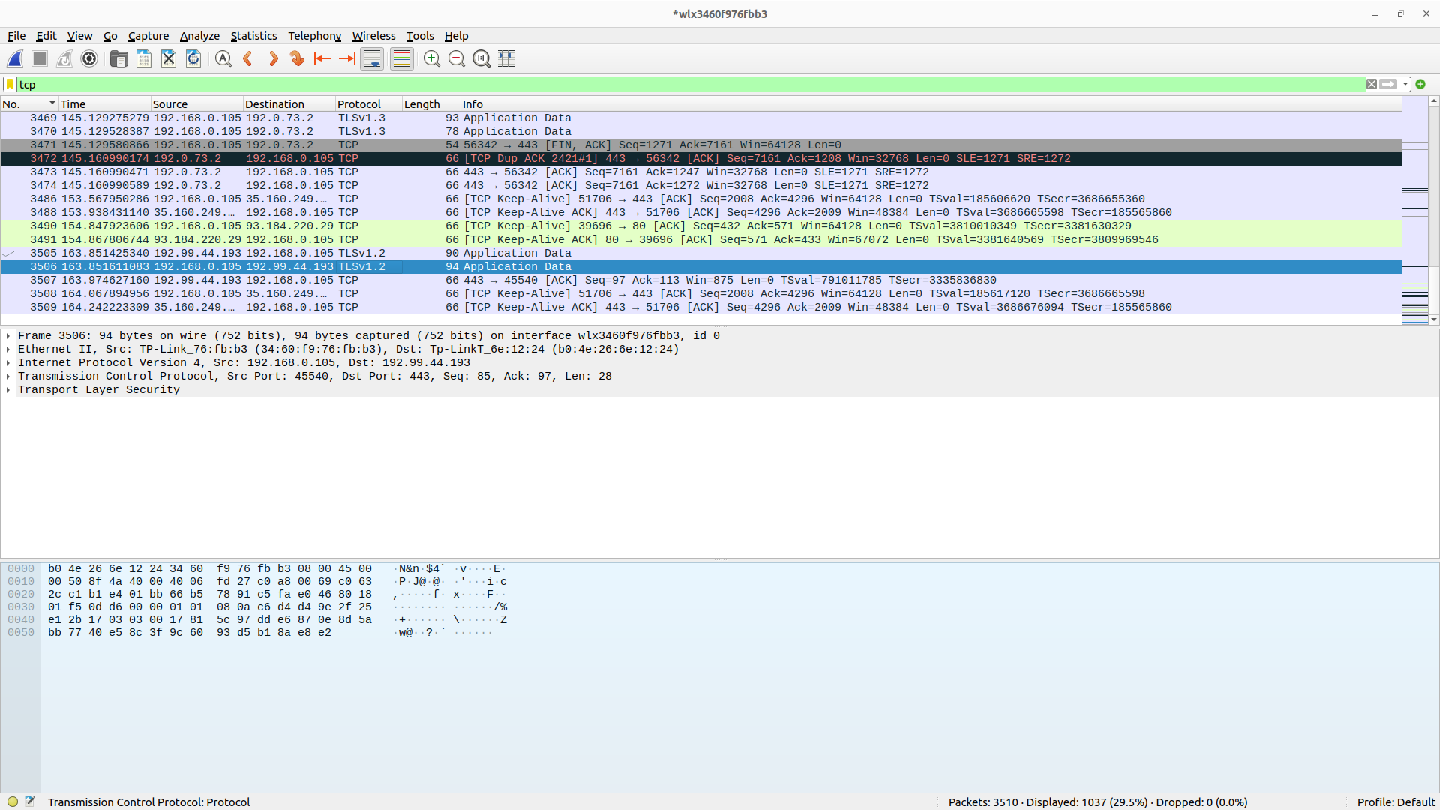
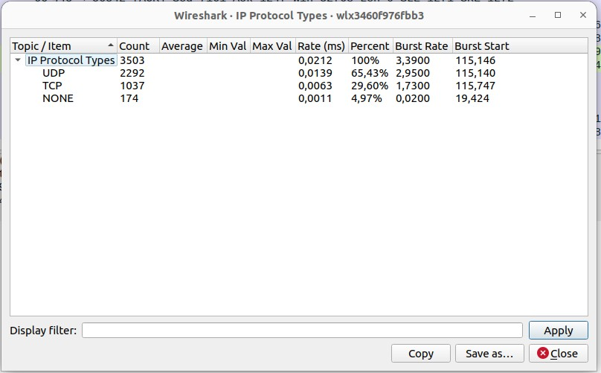
by writing “tcp” into the display filter I get all packets sent with the tcp protocol
ass we can see in the packet details TLSv1.2 is a type to tcp protocol.
By using statistics > IPV4 statistics > IP protocol types I get:
telling me that of 3503 packets 1037 are of the type TCP

Slide 14
XPath Syntax to find nodes that have specific attribute
Look into the following webpage:
http://www.pythonscraping.com/pages/warandpeace.html
On this page, the lines spoken by characters in the story are in read, whereas the names of characters are in green.
You can see the span tags, which reference the appropriate CSS classes, in the following sample of the page's source code:
<span class="red">Heavens! What a virulent attack!</span> replied
<span class="green">the prince</span>, not in the least disconcerned
By this reception.
Write XPath expression to select elements that are red.
//span[contains(@class, 'red')]
Obligatory Exercise: Task 4

Slide 15
XPath Syntax to select nodes with names equal to or containing some string
Select nodes based on node name
Sample XML
<College>
<FootBall>
<Members>20</Members>
<Coach>Archie Theron</Coach>
<Name>Wild cats</Name>
<StarPlayer>David Perry</StarPlayer>
</FootBall>
<VolleyBall>
<Members>24</Members>
<Coach>Tim Jose</Coach>
<Name>Avengers</Name>
<StarPlayer>Lindsay Rowen</StarPlayer>
</VolleyBall>
<FoosBall>
<Members>22</Members>
<Coach>Rahul Mehra</Coach>
<Name>Playerz</Name>
<StarPlayer>Amanda Ren</StarPlayer>
</FoosBall>
</College>
Write an XPath expression that searches for nodes that has name that ends with Player,
Write the output below:
//*[ends-with(name(),"Player")]
Element='<StarPlayer>David Perry</StarPlayer>'
Element='<StarPlayer>Lindsay Rowen</StarPlayer>'
Element='<StarPlayer>Amanda Ren</StarPlayer>'
Obligatory Exercise: Task 5

Slide 16
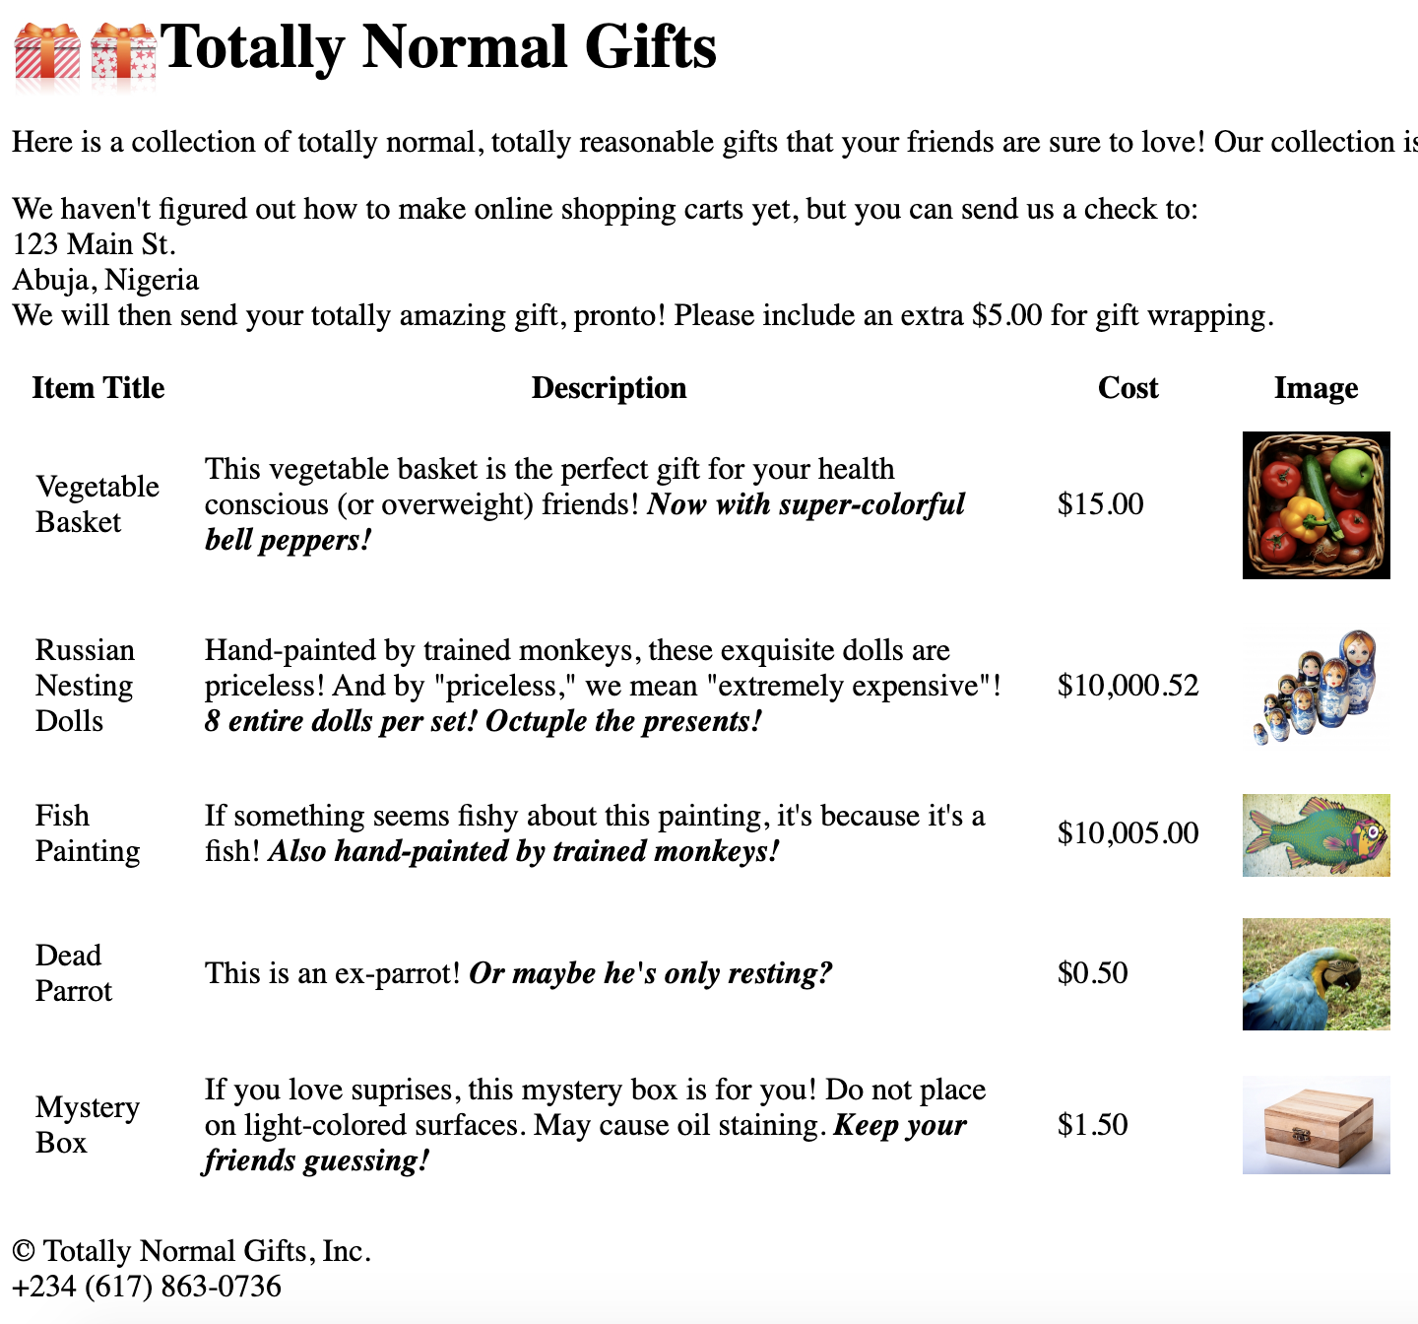
XPath Syntax to select nodes with names equal to or containing some string
Select nodes based on node name
Sample Webpage
See the HTML source of the webpage (http://www.pythonscraping.com/pages/page3.html) and write an XPath expression that selects the texts of Item titles, e.g., 'Vegetable Basket', 'Russian Nesting Dolls', etc.
Write the output below:
'//tr/td[1]/text()'
Array(5) [ #text, #text, #text, #text, #text ]​0: #text "\nVegetable Basket\n"​
1: #text "\nRussian Nesting Dolls\n"
​2: #text "\nFish Painting\n"
​3: #text "\nDead Parrot\n"
​4: #text "\nMystery Box\n"
http://www.pythonscraping.com/pages/page3.html
Obligatory Exercise: Task 6

Slide 17
XPath Syntax to select nodes with names equal to or containing some string
Select nodes based on node name
Sample Webpage
See the HTML source of the webpage (http://www.pythonscraping.com/pages/page3.html) and write an XPath expression that selects the texts of Cost for the first item, I.e,. $15.00.
But you have to start from the first image item:
//img[@src="../img/gifts/img1.jpg"]
Use parent, preceding-sibling, etc to select the text $15.00 ng::*
Write your XPath expression here:
Write the output below:
//img[@src="../img/gifts/img1.jpg"]/parent::td/preceding-sibling::*[1]/text()
​0: #text "\n$15.00\n"​length: 1​<prototype>: Array []
http://www.pythonscraping.com/pages/page3.html
Obligatory Exercise: Task 7

Slide 18
Developing Web Application with Django
In this assignment you must develop a Web application for a bookstore using Django framework. You must do the following:
Set up Django
Create a model for the bookstore in the database that the Django ORM will manage
Setup the view for at least 1 template showing all book items e.g., book-title, book-author.
Setup the url
To deliver the assignment, include screenshot of the following items:
- model.py
- view.py
- Screenshot showing the admin panel for book registration.
- Screenshot showing the webpage in a browser
Obligatory Exercise: Task 8

Slide 19
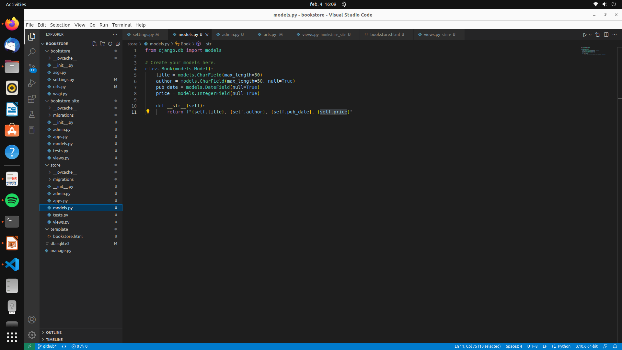

Slide 20
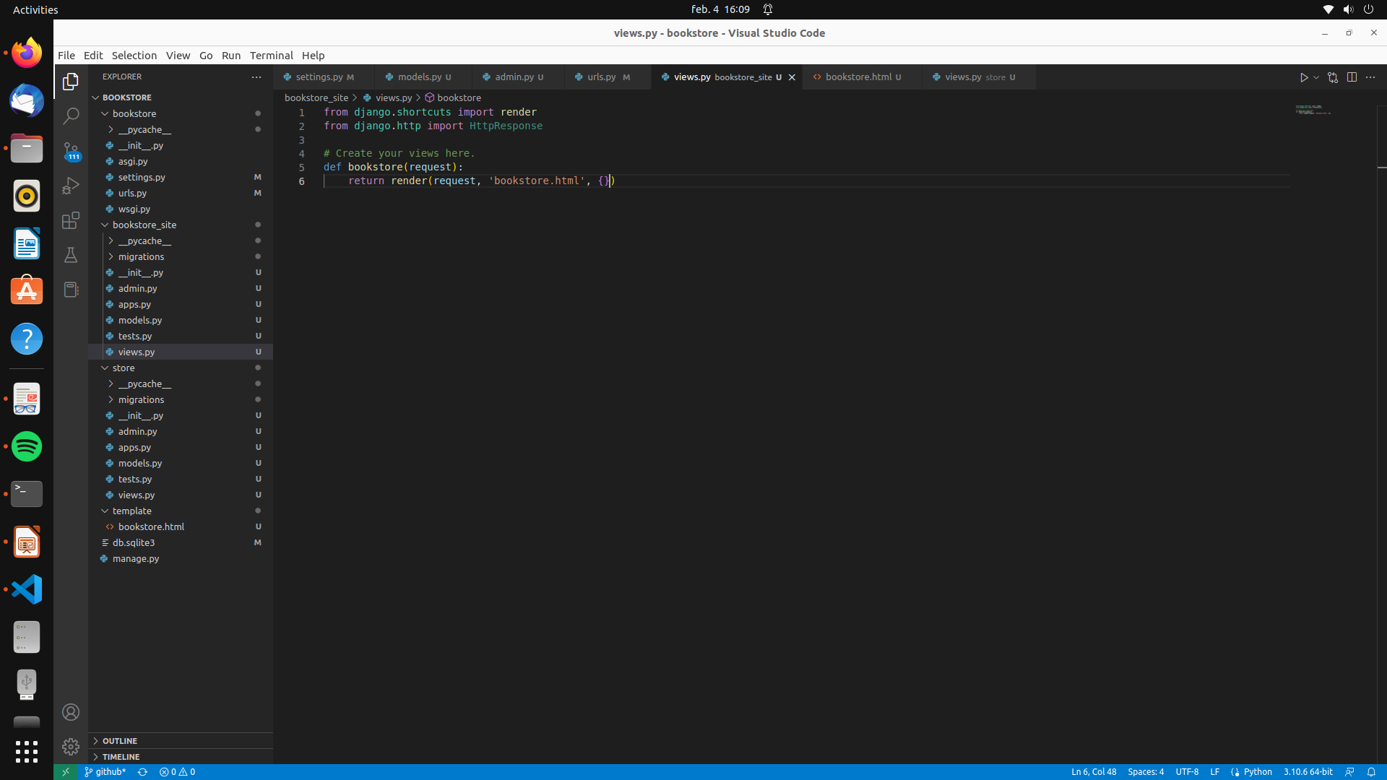

Slide 21
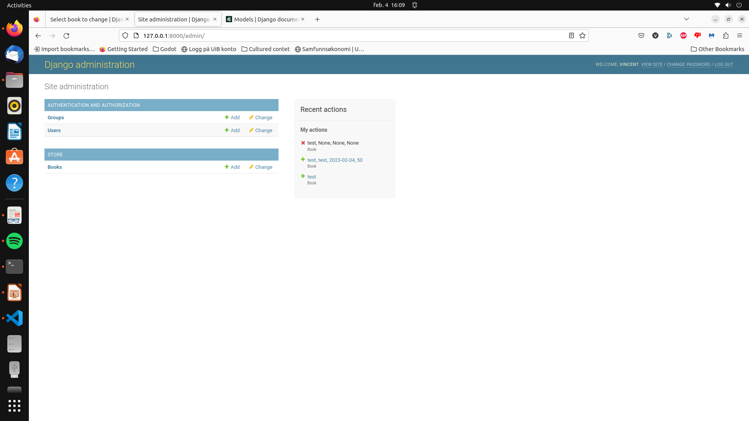

Slide 22
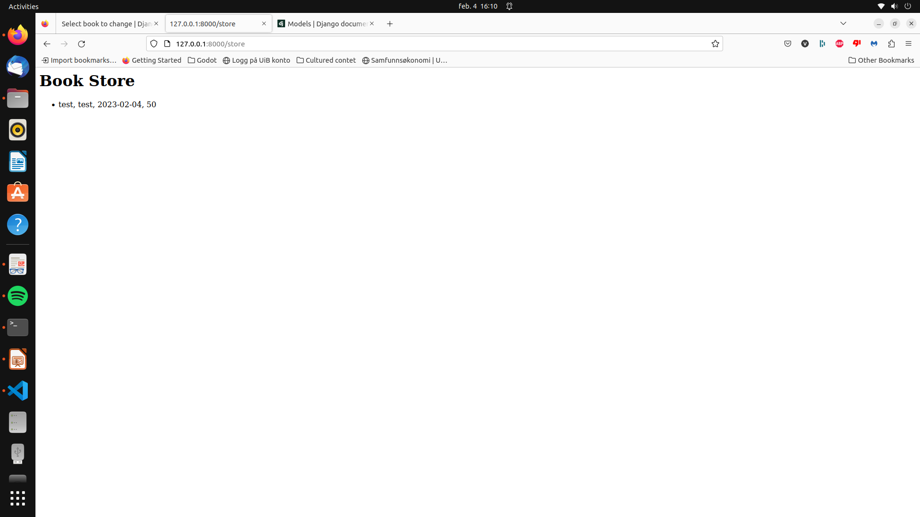

Slide 23
How to hand over the assignment?
Edit this PowerPoint file with your answers. Answers include
HTML code
Screenshot of Wireshark (You may add more slides if needed).
XPath expressions,
Output of XPath expressions,
Screenshot of the Django web project. (You may add more slides if needed).
Note:: Do not delete the projects from your computer until your assignment is approved. Seminar leader will contact you if they need more information about your projects. You may have to provide more information/screenshot before the assignment is approved.
Obligatory Exercise

